Slide 1


Planar Micro-Resonators and Micro-Helix Geometries for Studying Single Protein Crystals with X-band EPR.
Jason W. Sidabras
D. Suter, E.J. Reijerse, A. Savitsky, W. Lubitz

Slide 2
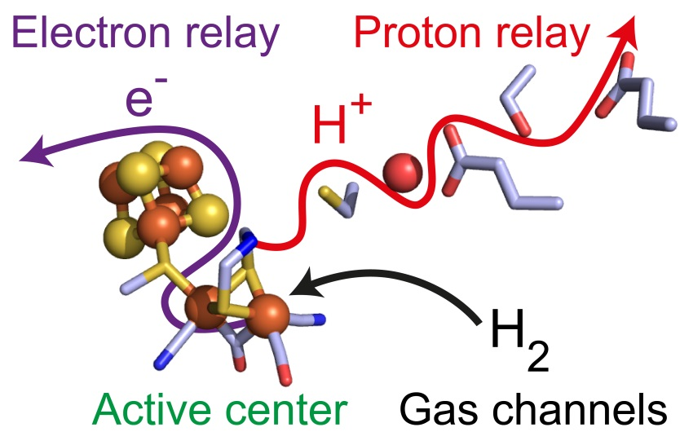
Motivation
Extremely Sample Limited
Nano-liter volumes at X-band
Materials Research
Samples of Limited Availability
Systems on a Chip/Micro-fluidics
Single Protein Crystals
Hydrogenase
2H⁺ + 2e⁻ ⇌ H₂
Understanding the mechanism of biological hydrogen conversion

Slide 3
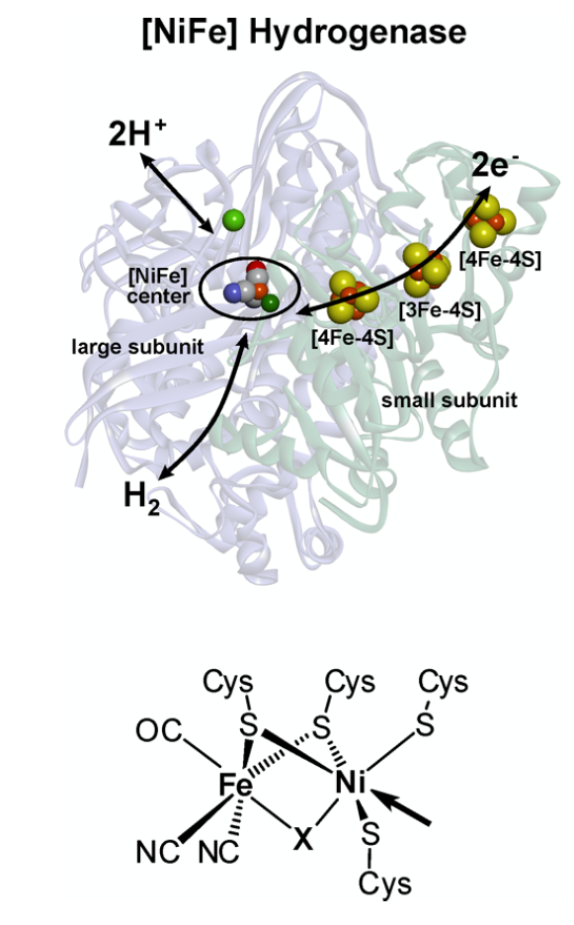
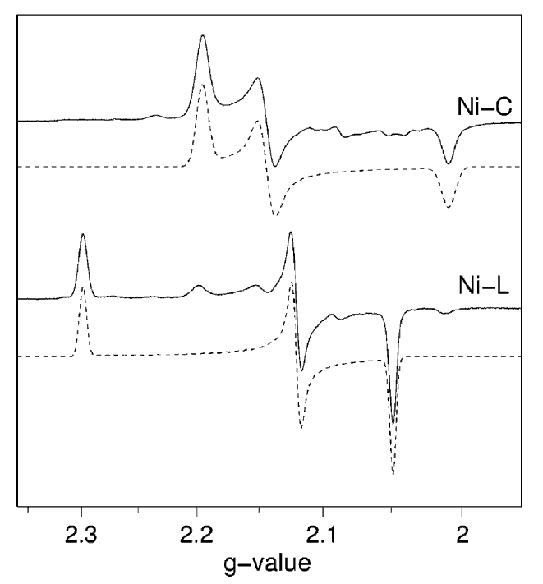
Why Single Protein Crystals?
EPR with Single Crystals:
Hydrogenase catalytic cycle has various redox states and several are paramagnetic
Disentangle angular dependencies of g- and A-tensors
Give insights into molecular interactions at the active site by relating to the X-ray Crystal Structure
Quantum Chemical Calculations to understand catalytic mechanism the full g-tensors axis. EPR data helps develop the calculations
Active Site
50-1000 nanoliter
Lubitz, Ogata, Rüdiger, Reijerse, Hydrogenases, Chem. Rev., 114, 2014
Foerster, Stein, Brecht, Ogata, Higuchi, Lubitz, Single Crystal EPR Studies of the Reduced Active Site of [NiFe] Hydrogenase from Desulfovibrio vulgaris Miyazaki F, JACS, 125, 2003
Notes:
----- Meeting Notes (9/8/16 15:12) -----
Talk less about it. Just that its been done before. Move to the front.
Orientation dependence.
----- Meeting Notes (3/30/17 16:58) -----
Protein single crystal
disentagle
full tensor information, best for even testing DFT
Quantum Chemical Calcuations not DFT

Slide 4
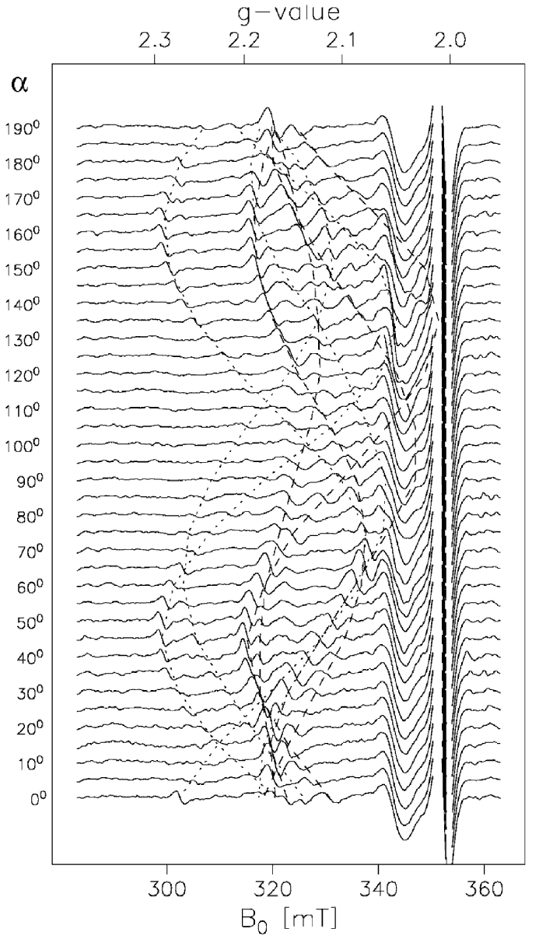
Why Single Protein Crystals?
EPR with Single Crystals:
Hydrogenase catalytic cycle has various redox states and several are paramagnetic
Disentangle angular dependencies of g- and A-tensors
Give insights into molecular interactions at the active site by relating to the X-ray Crystal Structure
Quantum Chemical Calculations to understand catalytic mechanism the full g-tensors axis. EPR data helps develop the calculations
Active Site
50-1000 nanoliter
Lubitz, Ogata, Rüdiger, Reijerse, Hydrogenases, Chem. Rev., 114, 2014
Foerster, Stein, Brecht, Ogata, Higuchi, Lubitz, Single Crystal EPR Studies of the Reduced Active Site of [NiFe] Hydrogenase from Desulfovibrio vulgaris Miyazaki F, JACS, 125, 2003
Notes:
----- Meeting Notes (9/8/16 15:12) -----
Talk less about it. Just that its been done before. Move to the front.
Orientation dependence.
----- Meeting Notes (3/30/17 16:58) -----
Protein single crystal
disentagle
full tensor information, best for even testing DFT
Quantum Chemical Calcuations not DFT

Slide 5
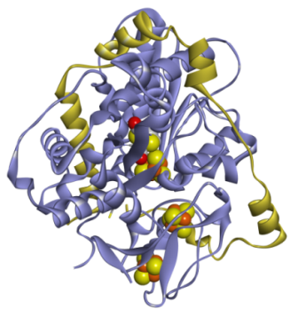
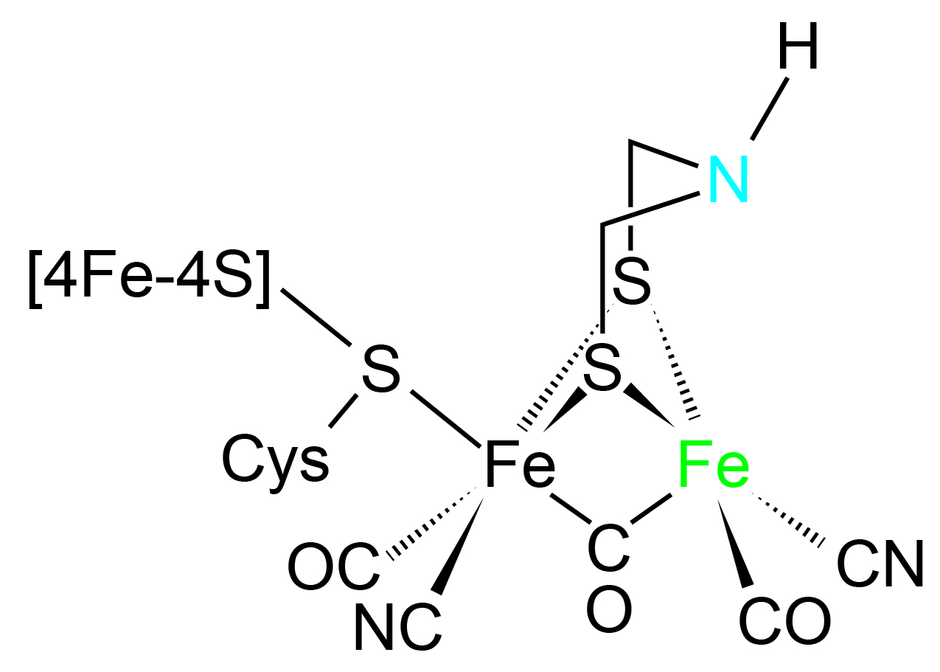
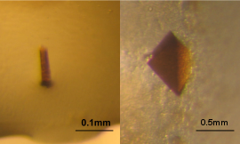
Single Protein Crystal [FeFe] Hydrogenase
D. desulfuricans HydAB
To date no single crystal studies have been performed on [FeFe] Hydrogenase
Using FTIR, EPR, NMR, Raman, and NRVS a convincing catalytic cycle has been hypothesized.
However, it is very difficult to hypothesize the F-clusters and g-tensors axis, single protein crystals are needed.
0.5-50 nanoliter
Lubitz, Ogata, Rüdiger, Reijerse, Hydrogenases, Chem. Rev., 114, 2014
Notes:
----- Meeting Notes (3/30/17 16:58) -----
7-10 A

Slide 6
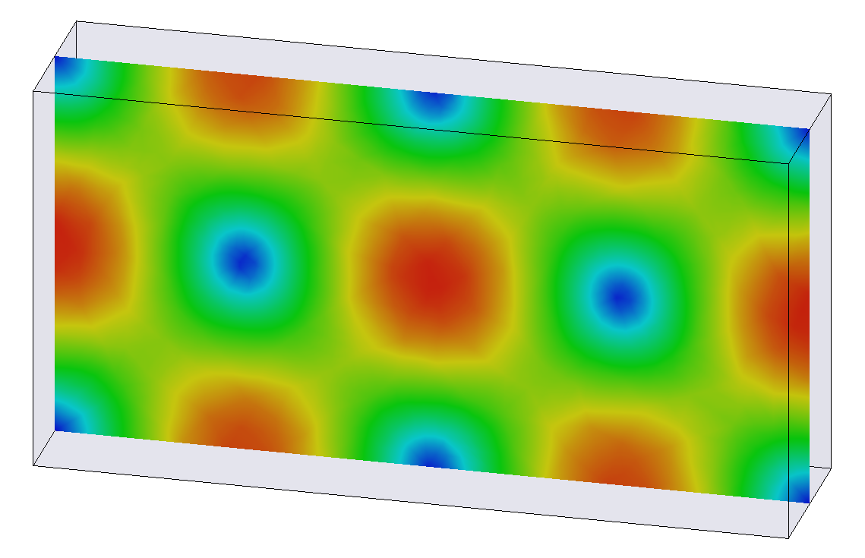
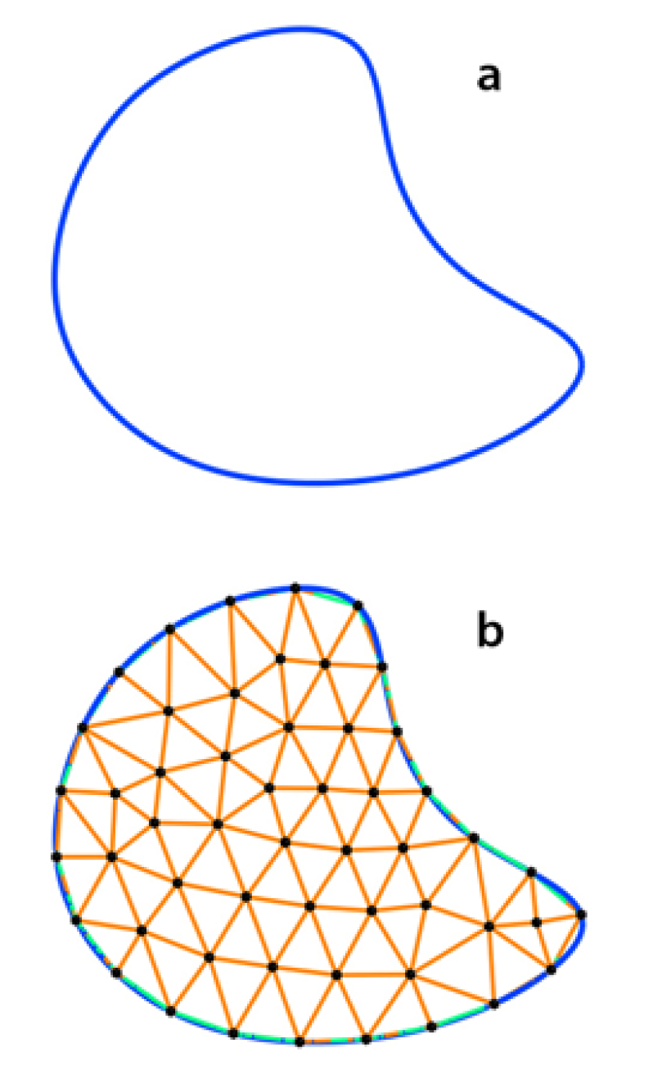
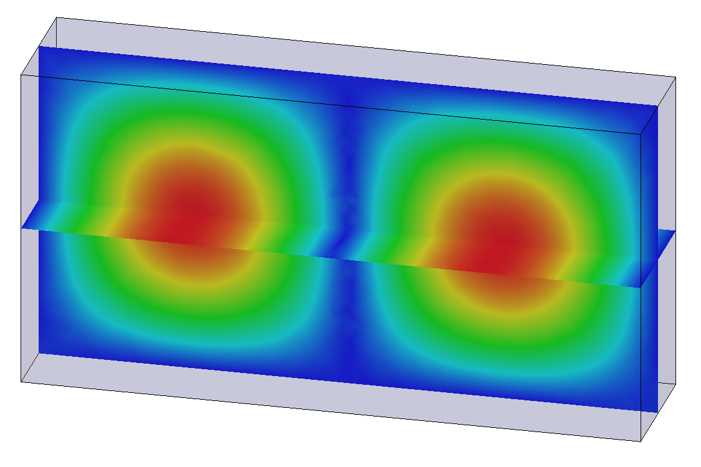
Resonator Introduction
Rectangular TE₁₀₂
Finite-Element Modeling
Ansys HFSS solves the full-wave Maxwell’s Equations for a given geometry and boundary condition
Build and Test on the Bench
Characterize the resonators and compare to simulation
Measure coupling, frequency, and Q-value
Experiments with Standard Samples
Further characterize the resonators using EPR
Sample handling (very important)
Magnetic field magnitude
Electric field magnitude
Notes:
----- Meeting Notes (3/30/17 16:58) -----
title methods

Slide 7
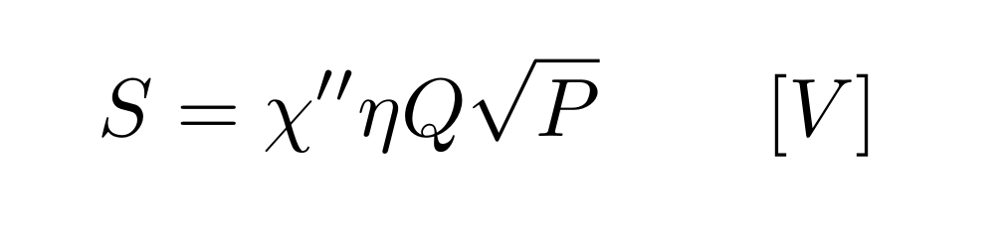
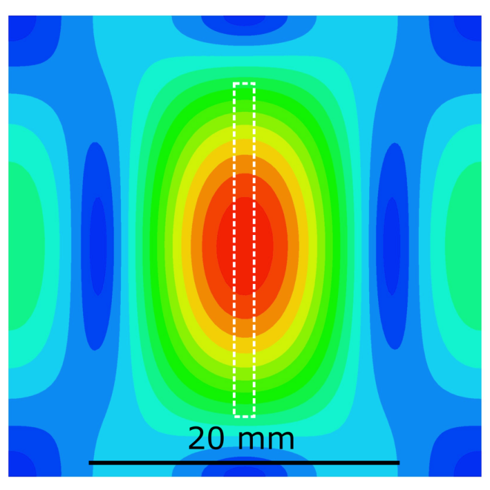
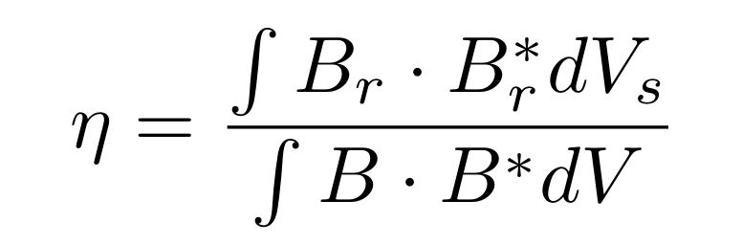
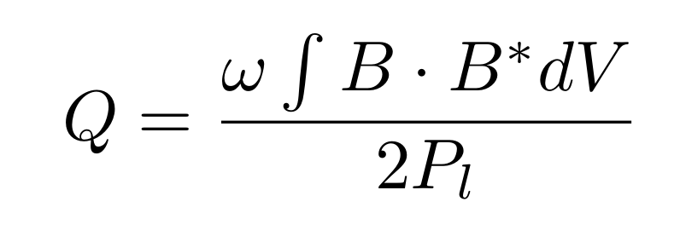
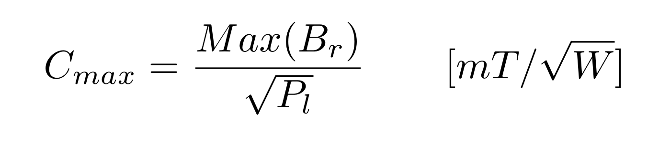
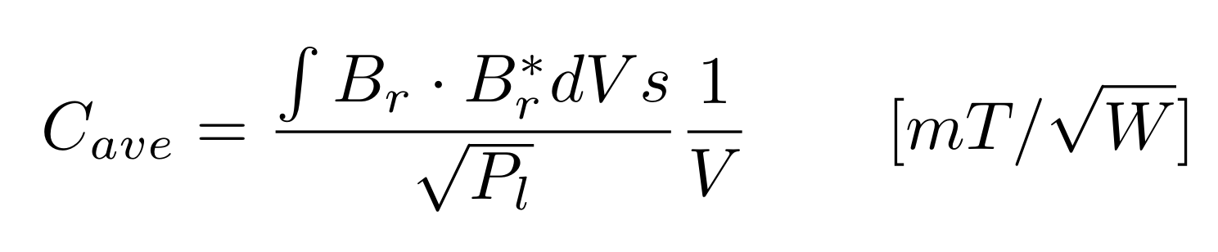
Resonator Characteristics
Based on a critically coupled resonator and reflection bridge configuration
Signal:
Cylindrical TE₀₁₁
Filling Factor
Q-value
Conversion Factor
Feher, Sensitivity Considerations in Microwave Paramagnetic Resonance Absorption Techniques, 36(2). 449,1957
Hyde, Froncisz, Advanced EPR: Applications in Biology and Biochemistry, Elsevier, 1989, Ch. 7: Loop-gap resonators, 277
Notes:
----- Meeting Notes (9/8/16 15:18) -----
finite-element modeling gives me these solutions
----- Meeting Notes (3/30/17 16:58) -----
mention TE011
square root sign
cavity resonators

Slide 8
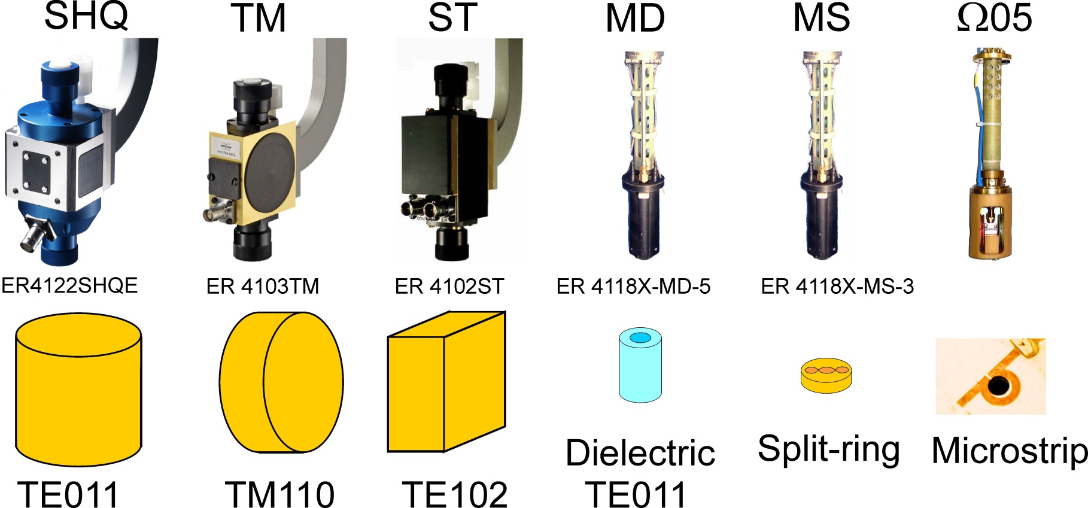
Increasing Sensitivity for Limited Samples
Twig, Suhovoy, Blank, A Sensitive surface loop-gap microresonators for electron spin resonance, Rev. Sci. Instrum., 81 (2010),104703.
Friendlander, Ovchar, Voigt, Bottcher, Belous, Poppl, Dielectric ceramic EPR Resonators for Low Emperature Spectroscopy at X-band Frequencies, Appl. Magn. Reson., 46 (2015), 33-48.

Slide 9
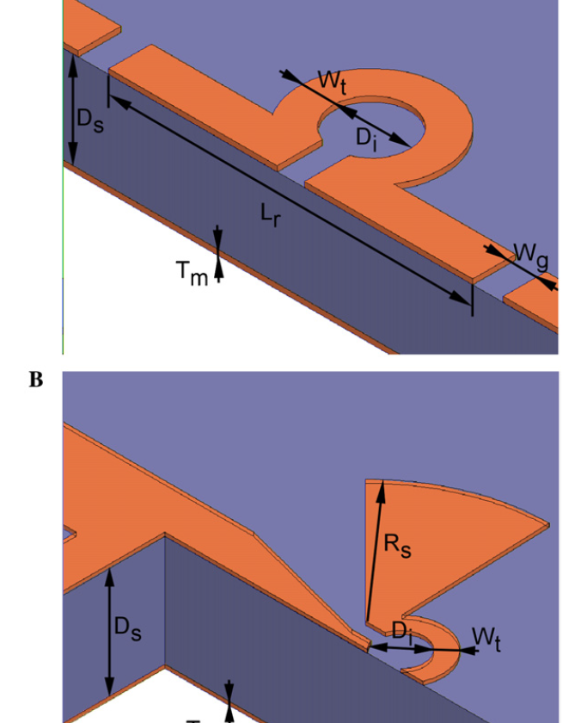
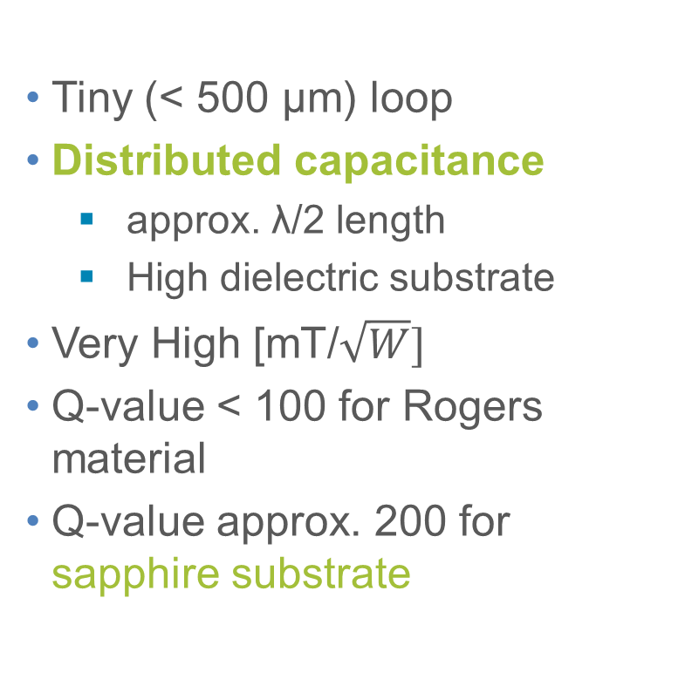
Planar Micro-Resonators for EPR
Tiny (< 500 μm) loop
Distributed capacitance
approx. λ/2 length
High dielectric substrate
Very High $\text{[}\text{mT}\text{/}\sqrt{W}\text{]}$
Q-value < 100 for Rogers material
Q-value approx. 200 for sapphire substrate
Narkowicz, Suter, Stonies, Planar microresonators for EPR experiments, J. Magn. Reson., 175, 2005

Slide 10
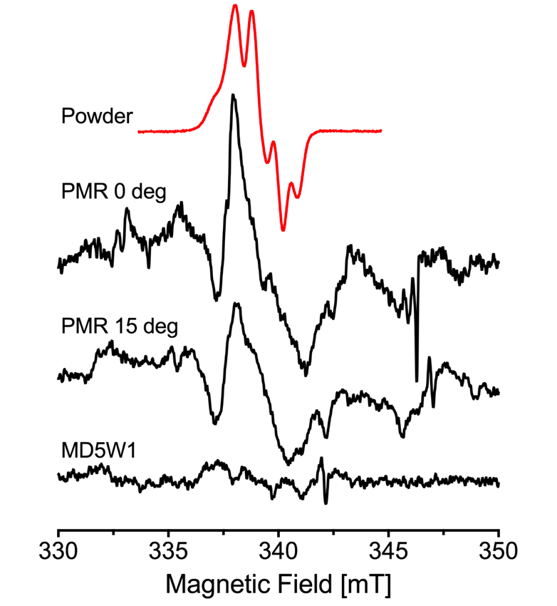
Planar Micro-Resonators Results
Experimental Results:
Tyrosine (Y_{D}*) Radical in Photosystem II
Single Crystal 0.3 x 0.3 x 0.5 mm³
0.6 x 10¹² spins/G
All simulations are performed with a 0.3 x 0.3 x 0.3 mm³ sample
Simulation | DR e=10 | 0.5 mm PMR
Freq. [GHz] | 9.52 | 9.58
Q₀-value | 15000 | 186
Su | 1.17 | 3.52
C_{max} | 1.2 | 3.3
C_{ave} | 1.2 | 2.4
Notes:
----- Meeting Notes (3/30/17 16:58) -----
measurements doing on a crystal
0.3 x 0.3 x 0.5

Slide 11
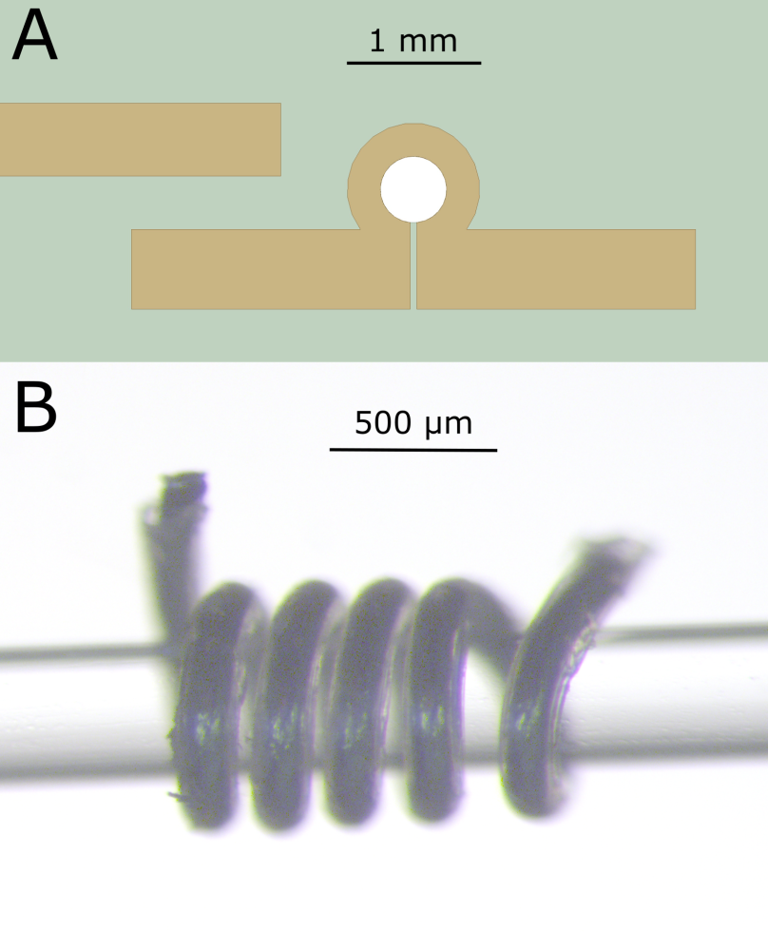
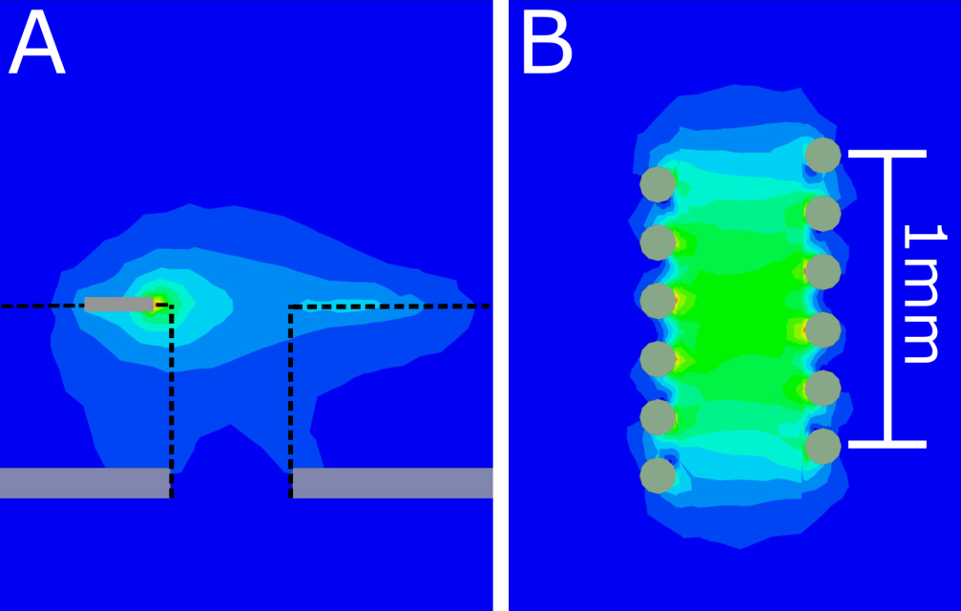
Micro Helix at X-band
Higher concentration of B₁
Higher Q-value (surface vs. volume)
More homogeneous field
Easier placement of small samples
1.2 mm Tall
5 windings 9.7 GHz
0.15 mm silver wire
0.4 mm inner diameter

Slide 12
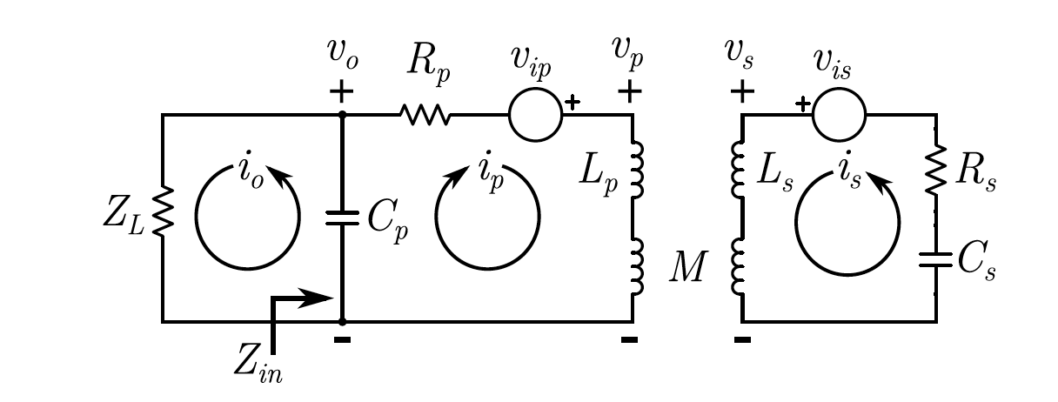
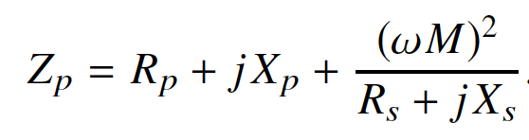
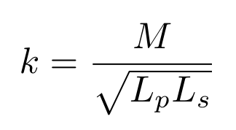
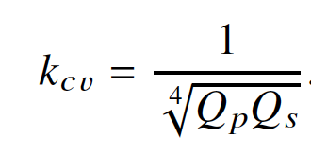
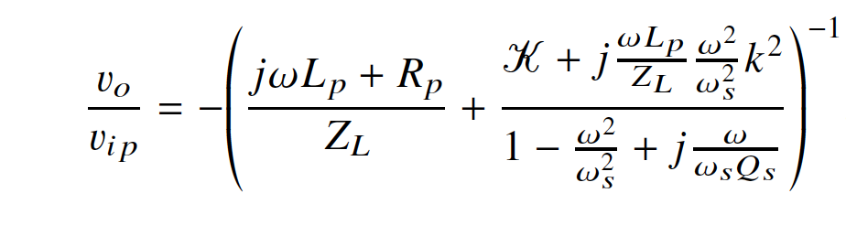
Coupling with Large Mutual Inductance
Coupling constant k is much larger than needed for maximum power transfer.
Instead the coupling constant is optimized for maximum impedance transfer.
The primary is then matched to the load for typical power transfer.
Output voltage is enhanced and noise is reduced.
Sidabras, Mett, Hyde, MRI surface-coil pair with strong inductive coupling, Rev. Sci. Instrum., 87, 124704, 2016

Slide 13
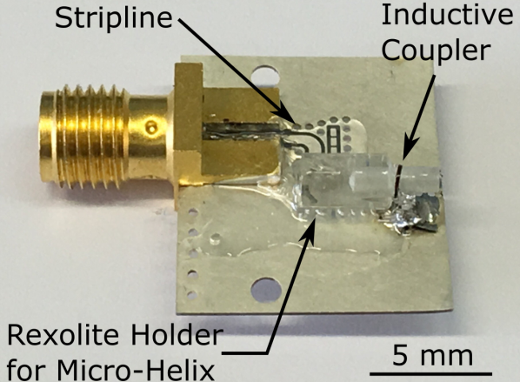
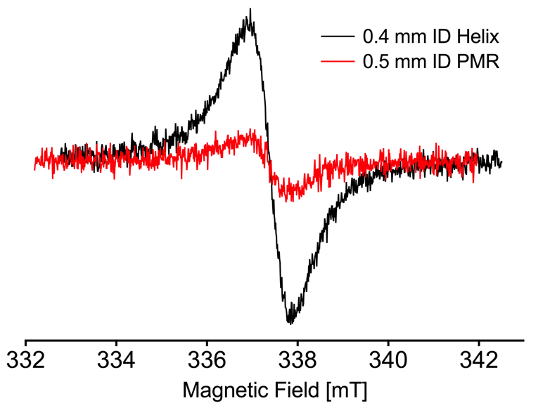
Preliminary Results
Simulation | DR e=10 | PMR 0.5 mm | Helix 0.46 mm
Freq. [GHz] | 9.52 | 9.58 | 9.78
Q₀-value | 15000 | 186 | 360
Su | 1.17 | 3.52 | 11.83
C_{max} | 1.2 | 3.3 | 4.4
C_{ave} | 1.2 | 2.4 | 4.2
0.4 mm Helix Measured
Q-value: 345
C_{ave} = 4.14
Signal [a.u.] = 106.25
Noise [a.u.] = 7.67
Measured
LiPC Crystal 0.2 x 0.2 x 0.1 mm
SNR = 13.84
0.5 mm PMR Measured
Sapphire
Q-value: 181
Signal [a.u.] = 24.75
Noise [a.u.] = 9.58
SNR = 2.58
Notes:
Add slide numbers
----- Meeting Notes (9/8/16 15:29) -----
LiF SHow which is which
----- Meeting Notes (3/30/17 16:58) -----
micro helix advantages
scale on

Slide 14
Summary and Future Work
*
*
*
*
Simulation | DR e=10 | 0.5 mm PMR | 0.1 mm PMR | Micro Helix 0.46 mm | Micro Helix 0.4 mm Thin wire | Micro Helix 0.17 mm
Freq. [GHz] | 9.52 | 9.58 | 9.68 | 9.77 | 9.78 | 9.66
Q₀-value | 15000 | 186 | 160 | 262 | 360 | 135
Su | 1.17 | 3.52 | 41.42 | 5.02 | 11.83 | 35.91
C_{max} | 1.2 | 3.3 | 12.5 | 3.6 | 4.4 | 8.8
C_{ave} | 1.2 | 2.4 | 8.1 | 3.3 | 4.2 | 8.5
* Experimentally Verified
Sample handling, including a goniometer
Repeatable Micro Helix fabrication and manufacturing techniques
Test Helix below 80K
Multi-frequency EPR: X-band, Q-band, 244 GHz

Slide 15




Acknowledgements
Prof. Dieter Suter
Dr. Nick Cox
Dr. Hideaki Ogata
Dr. Anton Savitsky
Dr. Edward Reijerse
Prof. Wolfgang Lubitz
Marie Skłodowska-Curie Individual Fellowship, May 1st
http://act-epr.org
Notes:
----- Meeting Notes (3/30/17 16:36) -----
it is very difficult to figure out the F-clusters, g tensors axis were located in NiFe and help develop the calculations also g tensor axis for DFT!!
no real finalized DFT and g-tensor interactions
need g-tensor axis system for EDNMR/ENDOR
case study example
extremely limited introduction slide
in general, biological systems are of low symmetry so crystal structures don't give g-tensor info
in single crystals you can measure the g/A at room temp, and no averaging out the tensors
spings/G/s W-band 10^(7or8)
how improtant the structural axis interaction is, low symmetry high complex system
----- Meeting Notes (3/30/17 16:58) -----
mention Blanck PMR resonators
g strain higher at high frequency.
Q-band with Blank is in the works

